Slide 1
Structural Equation Modeling and Model Selection
BIO 5400: Analytical Methods in Community Ecology
Sept. 9, 2011

Slide 2
Purpose of SEM
Assumes that we actually KNOW something about our study system!
Which hypothesis is more informative to test?
Plant diversity does not vary with productivity
Plant diversity demonstrates a unimodal relationship with productivity

Slide 3
Primary Uses
Testing alternative, informative models (Wolkovich Ecology, Johnson and Omland TREE)
Differentiating multiple direct and indirect causal relationships (Smith et al. AmNat)

Slide 4
An Example
Positive effect
Negative effect
Recruitment
in open
Precipitation
Recruitment
beneath canopy
Cover
Abundance
Mortality
Butterfield et al. 2010 Ecology
Notes:
Rather than testing each of these relationships in isolation, can treat the whole model as a single hypothesis

Slide 5
Differentiating Multiple Causal Paths
Butterfield et al. 2010 Ecology
Notes:
Get different estimates for indirect relationships than one would by testing individual bivariate relationships. A simple example of this in Smith et al. this week.

Slide 6
Testing Model Fit
Chi-square test: difference between observed and model-implied covariances
χ²₍₃₎=3.39; P=0.34
Degrees of freedom =
n(n+1/2), where n is the
# of variables
Probability that the model deviates from the observed data; large P-values are good

Slide 7
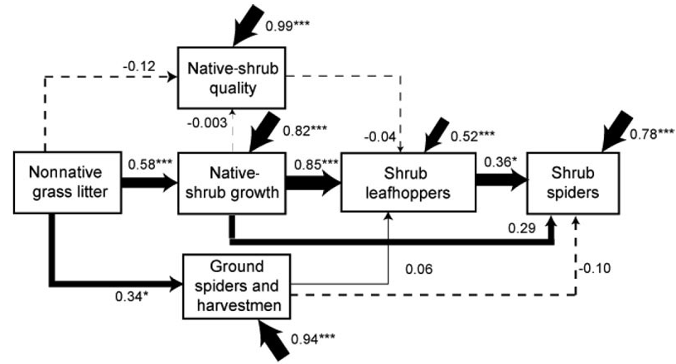
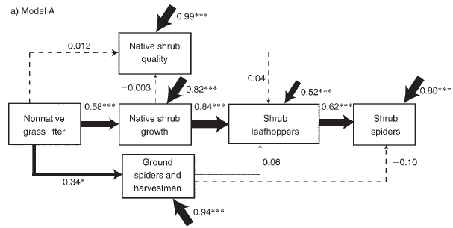
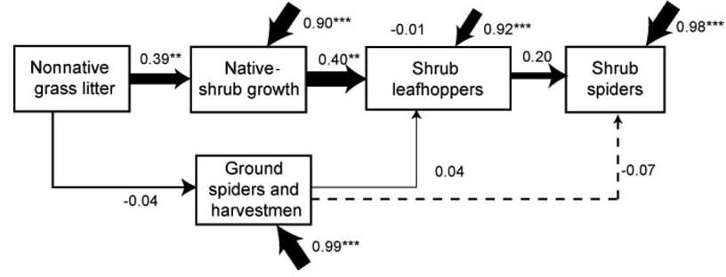

Testing Multiple Models

Slide 8
Model Selection
Many things to consider
Parsimony
Information content
Ecological interpretability
Many different approaches (Johnson and Omland TREE), all of which can be applied to SEM

Slide 9

For More Information…
NC State SEM page:
http://faculty.chass.ncsu.edu/garson/PA765/structur.htm

